Slide 1
Action Items
Vocab for both reading & listening – one list /day
Sentence analysis for reading & listening
Follow documentary for 40-60 minutes / day / daily reading on NatGeo
Read out conversation – start using English from today
Plan for a mock test or home edition between 9/28-10/2

Slide 2

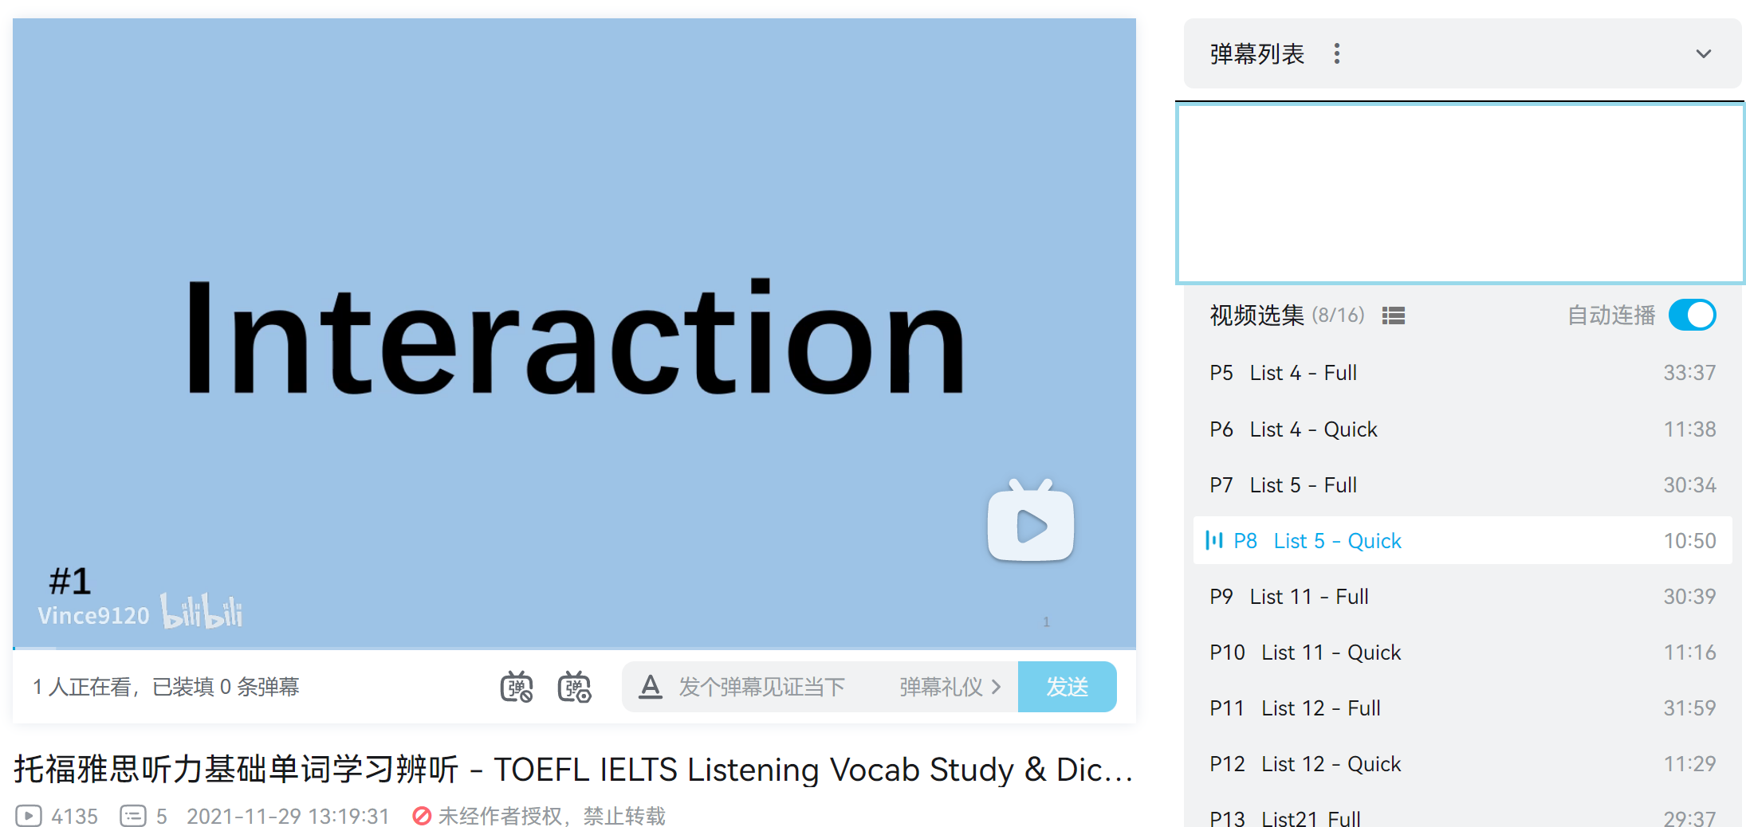
Phase 1
https://www.bilibili.com/video/BV1A341147JS/
Phase 1
CET 4
Reading = 100%
Listening >= 80%
Group9120

Slide 3
Synonym:
provide, prepare, supply
equip
v.
[ɪˈkwɪp]
Full understanding:
Instantaneous recognition in reading & listening
Part of speech & other forms
Synonyms or explanation
Example of application
Other forms:
equipment n.
Example:
The army is well-equipped.
Group9120
装备

Slide 4
Synonym:
provide, prepare, supply
equip
v.
[ɪˈkwɪp]
Full understanding:
Instantaneous recognition in reading & listening
Part of speech & other forms
Synonyms or explanation
Example of application
Other forms:
equipment n.
Example:
The army is well-equipped.
Group9120
装备

Slide 5
Synonym:
provide, prepare, supply
equip
v.
[ɪˈkwɪp]
Full understanding:
Instantaneous recognition in reading & listening
Part of speech & other forms
Synonyms or explanation
Example of application
Other forms:
equipment n.
Example:
The army is well-equipped.
Group9120
装备

Slide 6
Synonym:
provide, prepare, supply
equip
v.
[ɪˈkwɪp]
Full understanding:
Instantaneous recognition in reading & listening
Part of speech & other forms
Synonyms or explanation
Example of application
Other forms:
equipment n.
Example:
The army is well-equipped.
Group9120
装备

Slide 7
Synonym:
provide, prepare, supply
equip
v.
[ɪˈkwɪp]
Full understanding:
Instantaneous recognition in reading & listening
Part of speech & other forms
Synonyms or explanation
Example of application
Other forms:
equipment n.
Example:
The army is well-equipped.
Group9120
装备

Slide 8
Phase 1
Daily Plan
One new list
+
Review the one from yesterday
+
Review one or more previous list(s)

Slide 9
Phase 1
Daily Plan
Day 1
Day 2
Day 3
Day 4
Day 5
1
2
1
3
2
1
4
3
2
One new list
+
Review the one from yesterday
+
Review one or more previous list(s)
Full Review
1-4
Pool for challenging vocab

Slide 10
Vocab Prep Plan
Phase 1
Phase 2
Phase 3
CET 4
+
Academic Vocab
CET 4
Vocab
Study from passages
Group9120

Slide 11

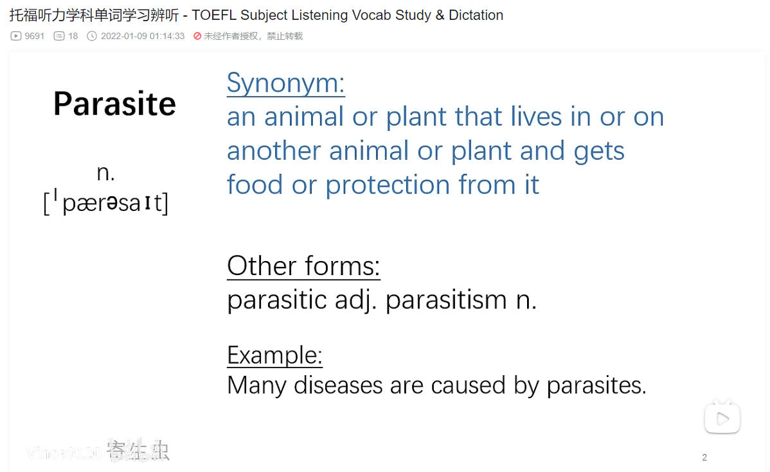
Phase 2
https://www.bilibili.com/video/BV19P4y1E7bz/
Phase 2
CET 4
+
Academic Vocab
Reading >= 80%
Listening >= 60%
Group9120

Slide 12

Vocabulary
Phase 2
Develop a full understanding on common academic vocabulary.
Parasite
Nomadic
Civilization
Dynamic
Noble…
CET 4
+
Academic Vocab
Reading >= 80%
Listening >= 60%

Slide 13
Vocabulary
Phase 2
Good understanding and instantaneous recognition on more technical terms
Primate
Orbit
Hydrogen
Neptune
Lunar…
CET 4
+
Academic Vocab
Reading >= 80%
Listening >= 60%
Group9120

Slide 14
Phase 2
Week 1
Week 2
Week 3
Week 4
CET 4
List 1-5
+
Life Science
生物，动物，植物，自然
CET 4
List 6-10
+
Social & Humanity
社会，历史与考古，人类，人物，经济
+
复习
Life Science
生物，动物，植物，自然
CET 4
List 11-15
+
Social & Humanity
教育，语言，宗教，政治，法律
+
复习
Social & Humanity
社会，历史与考古，人类，人物，经济
CET 4
List 16-20
+
Natural Science
物理，化学，地质地理，天文
+
复习
Social & Humanity
教育，语言，宗教，政治，法律

Slide 15
Phase 2
Week 5
Week 6
Week 7
Week 8
CET 4
List 21-25
+
Natural Science
医学，气象
+
复习
Natural Science
物理，化学，地质地理，天文
CET 4
List 26-30
+
Life Science
Full Review
+
复习
Natural Science
医学，气象
CET 4
List 31-35
+
Social Science & Humanity
Full Review
CET 4
Full Review
+
Natural Science
Full Review
Group9120

Slide 16
Action Items
Vocab for both reading & listening – one list /day
Sentence analysis for reading & listening
Follow documentary for 40-60 minutes / day / daily reading on NatGeo
Read out conversation – start using English from today
Plan for a mock test or home edition between 9/28-10/2

Slide 17
DDT and similar pesticides created the delusion that pests could be not merely controlled but eradicated, while public health workers saw in DDT the hope of controlling mosquitoes, which spread diseases such as malaria.
Group9120

Slide 18
Quiz
Please paraphrase the sentence
DDT and similar pesticides created the delusion that pests could be not merely controlled but eradicated, while public health workers saw in DDT the hope of controlling mosquitoes, which spread diseases such as malaria.
DDT和其他相似的杀虫剂创造了一种害虫不仅可以被控制而且可以被根除 (eradicate)的假象, 与此同时公共卫生工作者从DDT中看到了控制可能会传播疟疾(malaria)的蚊子的希望。
Group9120

Slide 19
Quiz
Please paraphrase the sentence
DDT和其他相似的杀虫剂创造了一种害虫不仅可以被控制而且可以被根除 (eradicate)的假象, 与此同时公共卫生工作者从DDT中看到了控制可能会传播疟疾(malaria)的蚊子的希望。
？
Group9120

Slide 20
Action Items
Vocab for both reading & listening – one list /day
Sentence analysis for reading & listening
Follow documentary for 40-60 minutes / day / daily reading on NatGeo
Read out conversation – start using English from today
Plan for a mock test or home edition between 9/28-10/2

Slide 21
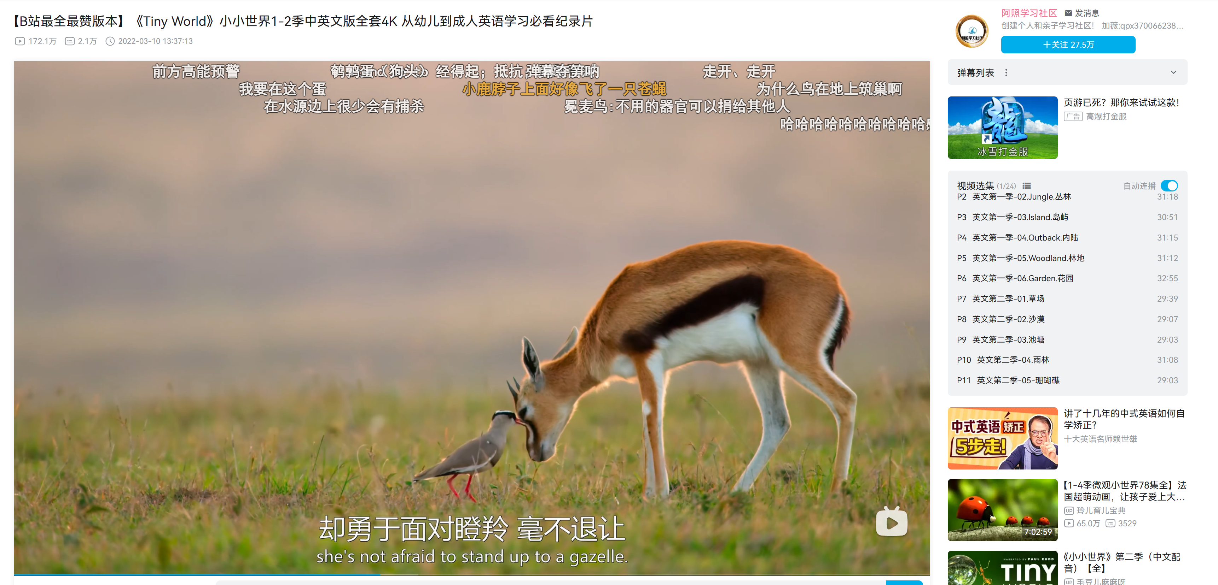
30-45 minutes / day
纪录片 英语字幕
Documentary with subtitles in English

Slide 22
Action Items
Vocab for both reading & listening – one list /day
Sentence analysis for reading & listening
Follow documentary for 40-60 minutes / day / daily reading on NatGeo
Read out conversation – start using English from today
Plan for a mock test or home edition between 9/28-10/2

Slide 23
Action Items
Vocab for both reading & listening – one list /day
Sentence analysis for reading & listening
Follow documentary for 40-60 minutes / day / daily reading on NatGeo
Read out conversation – start using English from today
Plan for a mock test or home edition between 9/28-10/2

Slide 24
